Slide 1
Movie recommendation sysytem
Submitted By: Submitted To:
Saurabh Singh (2K18/CO/329) Nipul Bansal
Rohan Dixit (2K18/CO/298)
Rohan Chandani (2K18/CO/297)

Slide 2
Movie recommendation system
Movie recommendation system try to know the characteristics and preferences of the user by collecting and analysing historical behavior to know what kind of person the user is, what kind of behavior preference the user has, what kind of things the user like to share and so on, and finally understand that user characteristics and preferences based on the rules of the platform and recommend the information and goods which the user interested.
Personalized recommendation system is a kind of information filtering technology.
It is an integrated system which is a combination of a variety of data mining algorithms and user related information, to meet the interests or potential interests of users.

Slide 3
Need of movie recommendation system
They help the user find items of their interest.
Helps the item provider to deliver their items to the right user – To identify the most relevant products for each user – Showcase personalised content to each user – Suggest top offers and discounts to the right user
Websites can improve user-engagement
It increases revenues for business through increased consumption

Slide 4
Research paper implemented
Design and Implementation of Movie Recommendation System Based on Knn Collaborative Filtering Algorithm
By:
Bei-Bei
CUI School of Software Engineering, Beijing University of Technology, Beijing, China

Slide 5
abstract
In the spread of information, how to quickly find one’s favorite movie in a large number of movies become a very important issue. Personalized recommendation system can play an important role especially when the user has no clear target movie. In this paper, we design and implement a movie recommendation system prototype combined with the actual needs of movie recommendation through researching of KNN algorithm and collaborative filtering algorithm. Then we give a detailed principle and architecture of JAVAEE system relational database model. Finally, the test results showed that the system has a good recommendation effect.

Slide 6
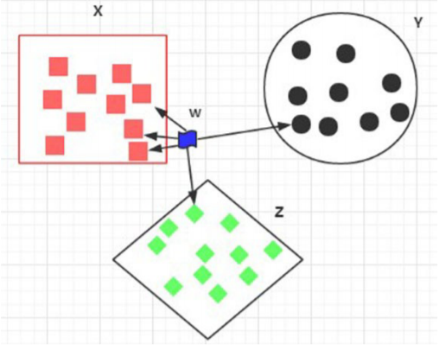
Knn algorithm
KNN algorithm KNN algorithm is called K nearest neighbor classification algorithm.
The core idea of the KNN algorithm is: if the majority of the k most similar neighbors of sample in the feature space belongs to a certain category, then the sample is considered to belong to this category.

Slide 7
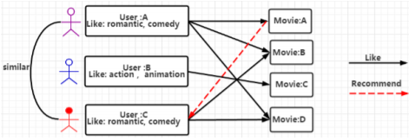
Collaborative filtering algorithm
The basic idea of collaborative filtering recommendation algorithm is to introduce the information of similar-interest users to object users.
The basic idea of the algorithm is based on records of history score of user. Find the neighbor user as u` who has the similar interest with target user u, and then recommend the items which the neighbor user u` loved to target user u, the predict score which target user u may give on the item is obtained by the score calculation of neighbor user u` on the item.
The algorithm consists of three basic steps: user similarity calculation, nearest neighbor selection and prediction score calculation.

Slide 8
Knn Collaborative filtering algorithm
KNN collaborative filtering algorithm, which is a collaborative filtering algorithm combined with KNN algorithm, use KNN algorithm to select neighbors. The basic steps of the algorithm are user similarity calculation, KNN nearest neighbor selection and predict score calculation.

Slide 9


User similarity computing
The similarity between users is calculated by evaluating the value of the items evaluated by two users. Each user uses N dimension vector to represent item score.
Cosine similarity: The method calculates the similarity between two users by calculating the cosine of the angle between the two vectors:
Pearson correlation similarity: Pearson correlation similarity is a measurement of the linear relationship between two variables.

Slide 10
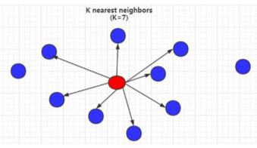
KNN nearest neighbor selection
After the calculation of similarity between users, then the algorithm selects a number of users the highest similarity as the U’s neighbor, denoted as u'. set a fixed value K for the neighbor selection, select only the most K high similarity as neighbors regardless of the value of the neighbor similarity of users.

Slide 11
Predict score calculation
The process of calculating prediction score of user u for i is as follows:
Step1. Generate user - item two-dimensional matrix of score as Rmxn, where each score is r_{u,i}.
Step2: Use principle of cosine similarity or Pearson correlation similarity to calculate the similarity between each 2 users, and generate the user similarity matrix.
Step3: according to the results obtained by Step2, find K number of score which has the maximum weight, the corresponding K users is the neighbors of u.
Step4: Use formula to calculate the predictive value of i for target user u.
In this way, we can calculate the prediction score of the target users for the non-scored movies, and the N movies with the highest score can be recommended to the user.

Slide 12
Personalized recommendation system design

Slide 13
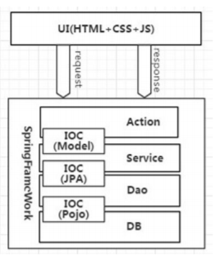
architecture design
The system is based on B/S mode, uses JavaEE architecture, Tomcat server for system deployment.
System Architecture Front view is implemented using HTML, CSS, JAVASCRIPT, the back end uses Struts2, Spring and Hibernate, the database uses MySQL for storage.
The system is object-oriented to guarantee system of high cohesion and improve development efficiency using the SSH protocol.
Besides, it enhances the maintainability and scalability by separating Controller layer and View layer to reduce the degree of coupling between them, making it easier to maintain and modify the WEB application.

Slide 14
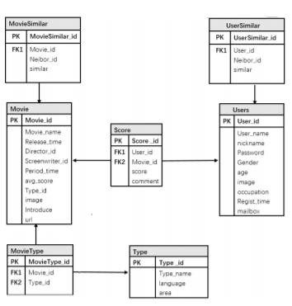
4.2Database design
System uses MYSQL database representing the integrity constraints between the data tables.
Users is the description of user information.
UserSimilar is the description of the user similarity information.
Score is the description of users’ rating information on the film, which is the direct information source of collaborative filtering algorithm.
Movie is the description of the movie information.
MovieType is the description of type information of the movies.
MovieSimilar is the description of the movie similarity information.
Both the table UserSimilar and Moviesimilar are the basis of the recommendation algorithm and system.

Slide 15
conclussion
Under the condition of massive information, the requirements of movie recommendation system from film amateur are increasing. Designs and implements a complete movie recommendation system prototype based on the KNN algorithm, collaborative filtering algorithm and recommendation system technology. We give a detailed design and development process, and test the stability and high efficiency of experiment system through professional test. This paper has reference significance for the development of personalized recommendation technology.

Slide 16
Thank you

